Slide 1
SADM GROUP PROJECT • GROUP 2 • FY26 PLANNING CYCLE
Microsoft Corporation
Regional & Segment Performance Analysis
Data-backed recommendations for FY26, built on FY24–FY25 quarterly performance data across five regions and three business segments.
Presented by
Group 2 – Microsoft | [Add team member names]

Slide 2
Business Context & Objective
OUR ROLE
THE DATASET
Business Analyst Intern, Corporate Strategy team — asked by the Head of Strategy to analyze two fiscal years of quarterly sales performance (FY24–FY25) and recommend where to focus for FY26.
240 simulated transaction-level records, FY24–FY25 (figures are simulated for academic use).
BUSINESS QUESTIONS
8 quarters
Q1 FY24 → Q4 FY25
1
Which regions & segments are driving profitable growth?
5 regions
NA, Europe, APAC, LatAm, MEA
2
Where are high operating costs eating into profit?
3
Which product lines / customer types deserve more FY26 investment?
3 business segments
Productivity & Biz Processes, Intelligent Cloud, More Personal Computing
4
Where is customer satisfaction slipping, and what needs correction?
9 product lines
incl. Azure, Office 365, LinkedIn, Windows, Xbox
3 customer types
Enterprise, SMB, Consumer
Microsoft Corporation | Regional & Segment Performance Analysis FY24–FY25
2

Slide 3
DELIVERABLE 1
Dashboard KPI Snapshot
$3,176.6M
831,972.5
$2,080.4M
$1,096.2M
TOTAL REVENUE
TOTAL UNITS SOLD
TOTAL OPERATING COST
TOTAL PROFIT
PROFIT BY QUARTER
▲ HIGHEST
▼ LOWEST
Q1 FY25 — $156.13M profit
Q3 FY24 — $112.85M profit
MANAGERIAL TAKEAWAY
Microsoft generated $1,096.2M in profit on $3,176.6M revenue (~34.5% margin) across the two years. Profitability swings quarter to quarter — FY26 planning should investigate what drove the strong Q1 FY25 result and what pressured margins in Q3 FY24, so the peak becomes repeatable rather than a one-off.
Microsoft Corporation | Regional & Segment Performance Analysis FY24–FY25
3

Slide 4
DELIVERABLE 2
Revenue Trend — FY24 vs FY25
WHAT IT MEANS
Revenue grew overall — from $379.6M in Q1 FY24 to $437.5M in Q4 FY25 — but the path isn't a straight line. Both years dip in Q2 before recovering, and FY25 sits consistently above FY24.
FY26 implication: build the plan around steady underlying growth, but budget for a seasonal Q2 softness rather than treating it as a one-off risk.
Microsoft Corporation | Regional & Segment Performance Analysis FY24–FY25
4

Slide 5
DELIVERABLE 3
Regional Performance
STRONGEST
North America
$900.5M revenue — the clear #1 region
WEAKEST
Middle East & Africa
$367.4M revenue — less than half of NA
RECOMMENDATION
Management should investigate demand generation, customer coverage, and local execution in Middle East & Africa — the gap to even the next-weakest region (Latin America) suggests a structural, fixable issue rather than market size alone.
Microsoft Corporation | Regional & Segment Performance Analysis FY24–FY25
5

Slide 6
DELIVERABLE 4
Business Segment & Product Line
INVEST MORE IN FY26
NEEDS ATTENTION
Intelligent Cloud segment & Azure product line — largest revenue base and clearest growth momentum.
Productivity & Business Processes segment & Dynamics 365 product line are underperforming and should be reviewed.
Microsoft Corporation | Regional & Segment Performance Analysis FY24–FY25
6

Slide 7
DELIVERABLE 5
Customer Satisfaction
WEAKEST OVERALL
Middle East & Africa
7.35 / 10 average — lowest of all 5 regions, and weakest in every customer type except Enterprise.
CORRECTIVE ACTION
Focus urgently on customer support and service quality in Middle East & Africa — particularly for SMB and Consumer accounts, where its scores trail every other region.
Microsoft Corporation | Regional & Segment Performance Analysis FY24–FY25
7

Slide 8
DELIVERABLE 6
Hypothesis Testing — Regional Satisfaction
Belief being tested: “Enterprise customers report similarly satisfied levels no matter which region serves them.”
H₀ (Null Hypothesis)
H₁ (Alternative Hypothesis)
Mean Enterprise satisfaction is equal across all five regions.
At least one region's mean Enterprise satisfaction differs from the others.
Test used: One-Way ANOVA (5 groups) • Significance level: α = 0.05
F Statistic | P-value | F Critical | Decision
0.618 | 0.651 | 2.494 | Fail to reject H₀
WHAT WE TELL MANAGEMENT
Since p = 0.651 is far above 0.05, we fail to reject H₀: Enterprise satisfaction is statistically similar across all five regions — the regional leadership's belief holds, and no single region is significantly pulling the average down. That said, Asia Pacific (7.65) and Middle East & Africa (7.60) have the numerically lowest means, so management may still want to monitor these two proactively.
Microsoft Corporation | Regional & Segment Performance Analysis FY24–FY25
8

Slide 9
DELIVERABLE 7–9
Correlation — What Drives Revenue?
Y (dependent): Revenue (USD Million) X candidates: Units Sold • Operating Cost • Customer Satisfaction Score
UNITS SOLD vs REVENUE
OPERATING COST vs REVENUE
r = 0.65
r = 0.97
Moderate positive relationship
Very strong positive relationship
SCATTER PATTERN CONFIRMS IT
The Revenue vs Units Sold scatter plot shows a moderate, fairly wide-spread positive trend — visually matching r = 0.65. The spread confirms units sold alone doesn't fully predict revenue: some low-volume transactions generate high revenue and vice versa.
MANAGERIAL TAKEAWAY
Revenue tracks operating cost far more tightly than it tracks unit volume. This tells management that deal scale / cost of delivery — not just “sell more units” — is what really drives the top line. High-value, higher-cost engagements matter more than volume alone.
Microsoft Corporation | Regional & Segment Performance Analysis FY24–FY25
9

Slide 10
DELIVERABLE 10–11
Regression Models & FY26 Recommendations
REVENUE ~ UNITS SOLD
REVENUE ~ CUSTOMER SATISFACTION
Revenue = 0.48 + 0.0037 × Units Sold
Revenue = 13.62 − 0.043 × Satisfaction
R² = 0.43 • Significant (p < 0.001)
R² ≈ 0.00 • Not significant (p = 0.95)
Prediction @ 5,000 units sold → ~$18.9M revenue
Satisfaction has virtually no direct, short-term revenue effect in this data.
Each extra unit sold adds ~$3,681 in revenue. Units explain 43% of revenue variation — the rest comes from pricing, product mix and customer type.
This doesn't mean satisfaction is unimportant — it drives long-term retention and loyalty. Invest in customer experience, but don't expect immediate revenue lift from it.
FY26 RECOMMENDATIONS
Double down on Intelligent Cloud & Azure — the clearest, largest revenue engines.
Review Productivity & Business Processes / Dynamics 365 performance before committing further investment.
Fix Middle East & Africa — weakest region on both revenue and satisfaction; investigate coverage and service quality.
Prioritize deal scale and operating efficiency over raw unit volume — cost of delivery correlates far more strongly with revenue.
Plan for a Q2 seasonal dip while continuing to build on the underlying growth trend.
Keep investing in customer experience for long-term retention, but track it separately from short-term revenue targets.
Microsoft Corporation | Regional & Segment Performance Analysis FY24–FY25
10

Slide 11
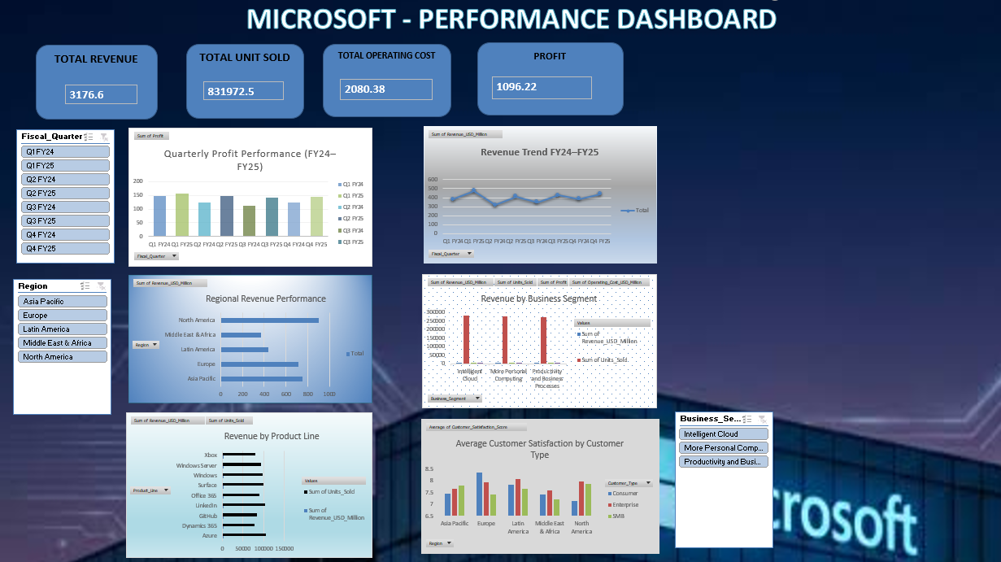
APPENDIX
Our Interactive Excel Dashboard
One-page dashboard (Excel) supporting all deliverables above — KPI cards, six charts, and management takeaways.
Microsoft Corporation | Regional & Segment Performance Analysis FY24–FY25
11

